Slide 1
Case Study Session 13
Course : COMP6153
Effective Period : September 2018

Slide 2
Sub Topics
Architecture
Process and Threads
Concurrency Mechanism
Scheduling
Memory Management
File Systems

Slide 3
These slides have been adapted from: Stallings, W. (2011). Operating Systems: Internals and Design Principles. 8^{th.} ISBN: 978-0-13-380591-8
Acknowledgement

Slide 4
Learning Objectives
At the end of this lecture, students are able to:
LO 2: Demonstrate different techniques used in designing UNIX / LINUX Operating System
LO 3: Relate the design techniques principles with the current techniqes used in UNIX / LINUX

Slide 5
Architecture

Slide 6
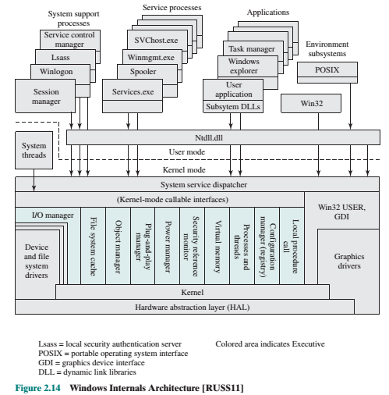
Windows Architecture

Slide 7
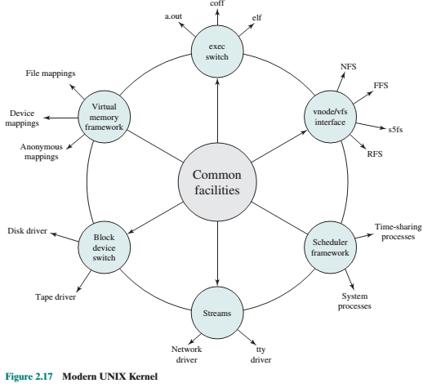
Modern Unix System

Slide 8
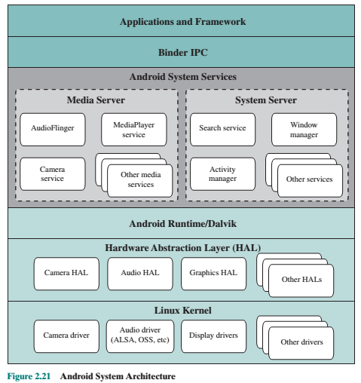
Android Architecture

Slide 9
Process and Threads

Slide 10
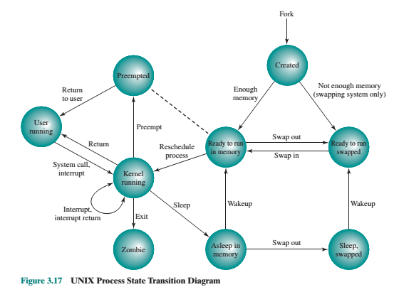
UNIX Process State Transition

Slide 11
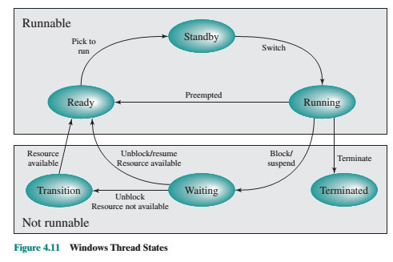
Windows Thread State Transition

Slide 12
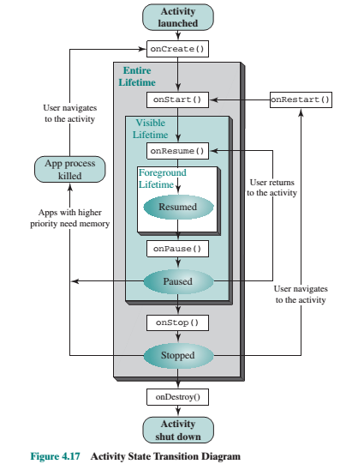
Android State Transition

Slide 13
Concurrency Mechanism

Slide 14
Unix
Pipes
Messages
Shared memory
Semaphores
Signals

Slide 15
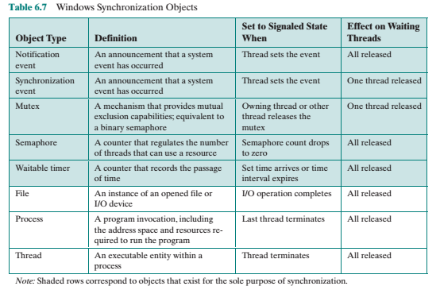
Windows

Slide 16
Android
Android adds to the kernel a new capability known as Binder.
Binder provides a lightweight remote procedure call (RPC) capability that is efficient in terms of both memory and processing requirements, and is well suited to the requirements of an embedded system.
The Binder is used to mediate all interaction between two processes.
A component in one process (the client) issues a call. This call is directed to the Binder in the kernel, which passes the call on to the destination component in the destination process (the service).
The return from the destination goes through the Binder and is delivered to the calling component in the calling process

Slide 17
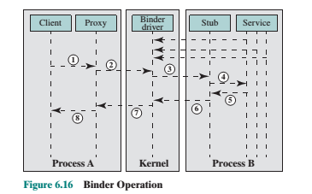
Android

Slide 18
Scheduling

Slide 19
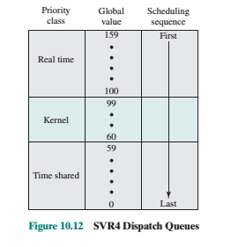
Unix
Real time (159-100): guaranteed to be selected to run before any kernel or time-sharing process. In addition, real-time processes can make use of preemption points to preempt kernel processes and user processes.
Priority Classes
Kernel (99-60: guaranteed to be selected
to run before any time-sharing process but must defer to real-time processes.
Time-shared (59-0):The lowest-priority processes, intended for user applications other than real-time applications

Slide 20
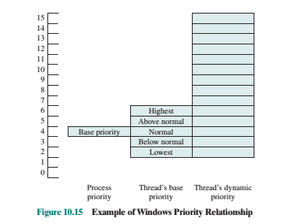
Windows
Priority Classes

Slide 21
Virtual Memory

Slide 22
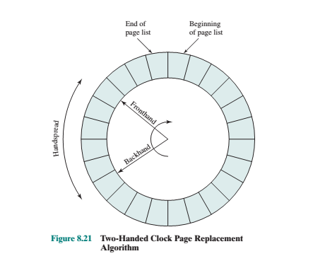
Unix Page Replacement
Two-handed clock

Slide 23
Windows Virtual Memory Manager
The Windows virtual memory manager controls how memory is allocated and how paging is performed.
The memory manager is designed to operate over a variety of platforms and to use page sizes ranging from 4 Kbytes to 64 Kbytes.
Intel and AMD64 platforms have 4 Kbytes per page and Intel Itanium platforms have 8 Kbytes per page

Slide 24
Windows Virtual Memory Manager
Using Working Set
When main memory is plentiful, the virtual memory manager allows the resident sets of active processes to grow. To do this, when a page fault occurs, a new physical page is added to the process but no older page is swapped out, resulting in an increase of the resident set of that process by one page.
When memory becomes scarce, the virtual memory manager recovers memory for the system by removing less recently used pages out of the working sets of active processes, reducing the size of those resident sets.

Slide 25
Android Memory Management
ASHMem:This feature provides anonymous shared memory, which abstracts memory as file descriptors. A file descriptor can be passed to another process to share memory.
Pmem:This feature allocates virtual memory so that it is physically contiguous. This feature is useful for hardware that does not support virtual memory.
Low Memory Killer : Most mobile devices do not have a swap capability (because of flash memory lifetime considerations). When main memory is exhausted, the application or applications using the most memory must either back off their use of memory or be terminated. This feature enables the system to notify an app or apps that they need to free up memory. If an app does not cooperate, it is terminated.

Slide 26
File Management

Slide 27
UNIX
6 file types
Regular
Directory
Special File
Named pipe
Link
Symbolic Link

Slide 28
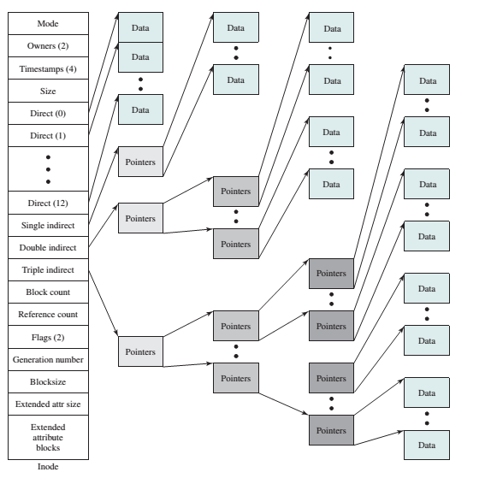
UNIX
Inodes

Slide 29
Windows
NTF
Sector: The smallest physical storage unit on the disk. The data size in bytes is a power of 2 and is almost always 512 bytes.
Cluster:One or more contiguous (next to each other on the disk) sectors. The ccluster size in sectors is a power of 2.
Volume:cA logical partition on a disk, consisting of one or more clusters and used by a file system to allocate space. At any time, a volume consists of file system information, a collection of files, and any additional unallocated space remaining on the volume that can be allocated to files. A volume can be all or a portion of a single disk or it can extend across multiple disks. If hardware or software RAID 5 is employed, a volume consists of stripes spanning multiple disks. The maximum volume size for NTFS is 2^64 clusters FS

Slide 30
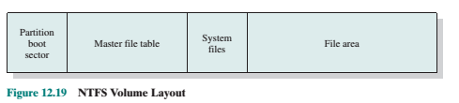
Windows volume layout

Slide 31
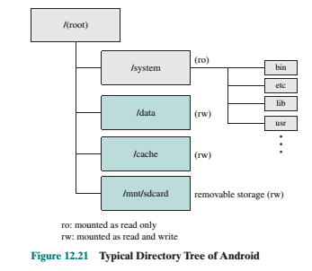
Android directory tree structure

Slide 32
References
Stallings, W. (2014). Operating Systems: Internals and Design Principles. 8^{th.} ISBN: 978-0-13-380591-8

